Slide 1
OSS-Based OSS Compliance Tooling April 5th @ here in Berlin
Siemens Corporate Technology 2019
CC-BY-SA-4.0

Slide 2
Agenda for Today - Morning
Topic | Presenting / Moderating | Time | Duration
Early Arrivers Meet and Greet | All | 09:00
Welcome and introduction round | All | 09:30 | 15
Tooling Updates SW360, SW360 antenna, quartermaster, O.R.T., ScanCode, Vulas, FOSSology | Thomas | 09:45 | 25
Recap of recent events | Thomas | 10:10 | 20
Questions and answers session | Michael J | 10:30 | 30
Coffee Break |  | 11:00 | 15
Process discussion Demo of process in various companies and identified gaps Capturing workflows in BPMN or other diagram format so they can be shared | All | 11:15 | 105
Lunch | All | 13:00 | 60

Slide 3
Agenda for Today - Afternoon
Topic | Presenting / Moderating | Time | Duration
Data Models Discussion Different models, open topics and gaps Work out logical next steps / targets | Oliver | 14:00 | 60
The FASTEN Project Quartermaster and ACT | Mirko | 15:00 | 30
Coffee Break | All | 15:30 | 15
Group break out on specific topics Tooling / code integrations Process Models | All | 15:45 | 60
Wrap up and Closing | All | 16:45 | 15

Slide 4
Welcome and Introduction

Slide 5
Project Updates (about 5 mins each)

Slide 6
Project Updates - Quartermaster
(please see separate slides)
qmstr.org

Slide 7
Project Updates - Vulas
(please see separate slides)
Michael Picht

Slide 8
Project Updates – Open Source Review Toolkit
(please see separate slides)
Github.com/here-maps/opensourcereviewtoolkit

Slide 9
Project Updates – Eclipse SW360Antenna
(please see separate slides)
www.eclipse.org/sw360antenna

Slide 10
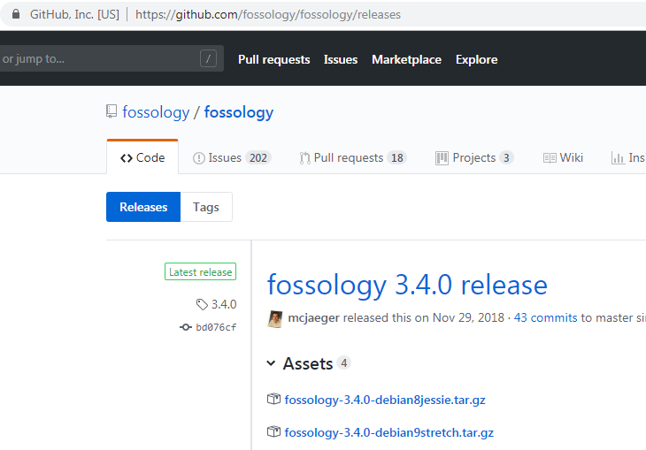
Project Updates - FOSSology
News since Last Meeting (Jan 2019)
Release 3.5.0 RC2
Since then
REST API changes
Improved copyright handling
Better JSON off the command line

Slide 11
Project Updates – FOSSology REST API
$ curl -k -s -S -X GET http://83.169.21.23/repo/api/v1/folders -H "Authorization: Bearer eyJ0eXAi..." $ curl -k -s -S -X POST http://83.169.21.23/repo/api/v1/folders -H 'parentFolder: 1' -H 'folderName: rest' -H "Authorization: Bearer eyJ0eXAi..." -> folder id $ curl -k -s -S -X GET http://83.169.21.23/repo/api/v1/folders -H "Authorization: Bearer eyJ0eXAi..." $ curl -k -s -S -X POST http://83.169.21.23/repo/api/v1/uploads \ -H "folderId: $folderId" -H 'uploadDescription: created by REST' \ -H 'public: public' -H 'Content-Type: multipart/form-data' \ -F 'fileInput=@"/tmp/zlib-1.2.11.tar.gz";type=application/octet-stream' \ -H "Authorization: Bearer eyJ0eXAi..." -> upload id $ curl -k -s -S -X POST http://localhost:8081/repo/api/v1/jobs \ -H "folderId: $folderId'" -H "uploadId: $uploadId" \ -H "Authorization: Bearer eyJ0eXAi..." \ -H 'Content-Type: application/json' --data '{ "analysis": { "bucket": true, "copyright_email_author": true, "ecc": true, "keyword": true,"mime": true, "monk": true, "nomos": true, "package": true }, "decider": { "nomos_monk": true, "bulk_reused": true, "new_scanner": true } }' $ curl -k -s -S -X GET http://localhost:8081/repo/api/v1/report \ -H "Authorization: Bearer eyJ0eXAi..." -H "uploadId: $uploadId" -H 'reportFormat: spdx2' -> spdx report id $ curl -k -s -S -X GET http://localhost:8081/repo/api/v1/report/$spdxReportId \ -H "Authorization: Bearer eyJ0eXAi..." \ -H 'accept: text/plain' > report.rdf.xml -> document on your hard drive
Complete flow, from upload to SPDX
Including token based auth
JWT
With read only
With expiration
Including decider options
Now, depending on use cases, more cases are easily added

Slide 12
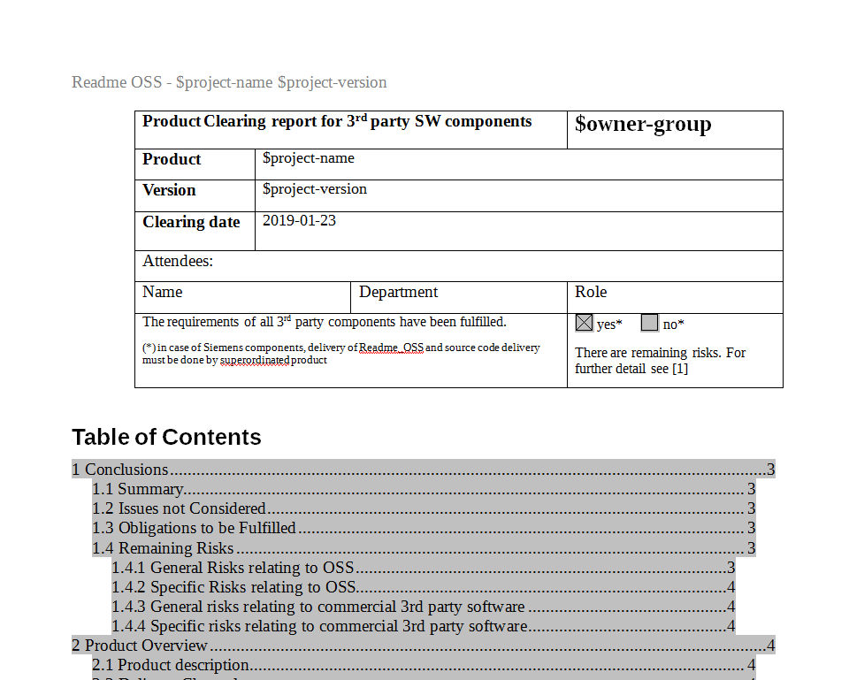
Project Updates - SW360
News since Last Meeting (Jan 2019)
Gradual updates
For example:
Improvement of the REST API
Access rights: who can change projects data?
Reporting
Right now: Project obligations

Slide 13
Marketing, New Members,
Upcoming Conferences

Slide 14
OSS-based OSS Compliance Tooling
Infrastructure
Files at Github: https://github.com/Open-Source-Compliance/Sharing-creates-value
Project Wiki: https://github.com/Open-Source-Compliance/Sharing-creates-value/wiki
Mailinglist:
https://groups.io/g/oss-based-compliance-tooling
Please consider mailing list: maintaining collection of E-Mails is really error-prone
Remember that mailing list is public

Slide 15
OSS-based OSS Compliance Tooling
New Contacts
Contacted Martin von Willebrandt / VALIDOS
Contacted OSS Group from Sweden: Industrial Open Source Network
Tooling Group at Bitkom

Slide 16
OSS-based OSS Compliance Tooling
Proposed Promotions
Legal Workshop of FSFE
Accepted general proposal (Mirko, Marcel, Oliver, Michael and Michael)
More conferences?

Slide 17
Questions and Answers From the previous slots

Slide 18
Questions about the existing tooling
Using the cards and whiteboard
Questions on tools
Qustions on the effort

Slide 19
Process Discussion

Slide 20
Process Discussion
Processes
What do we have
What do we want
Notation

Slide 21
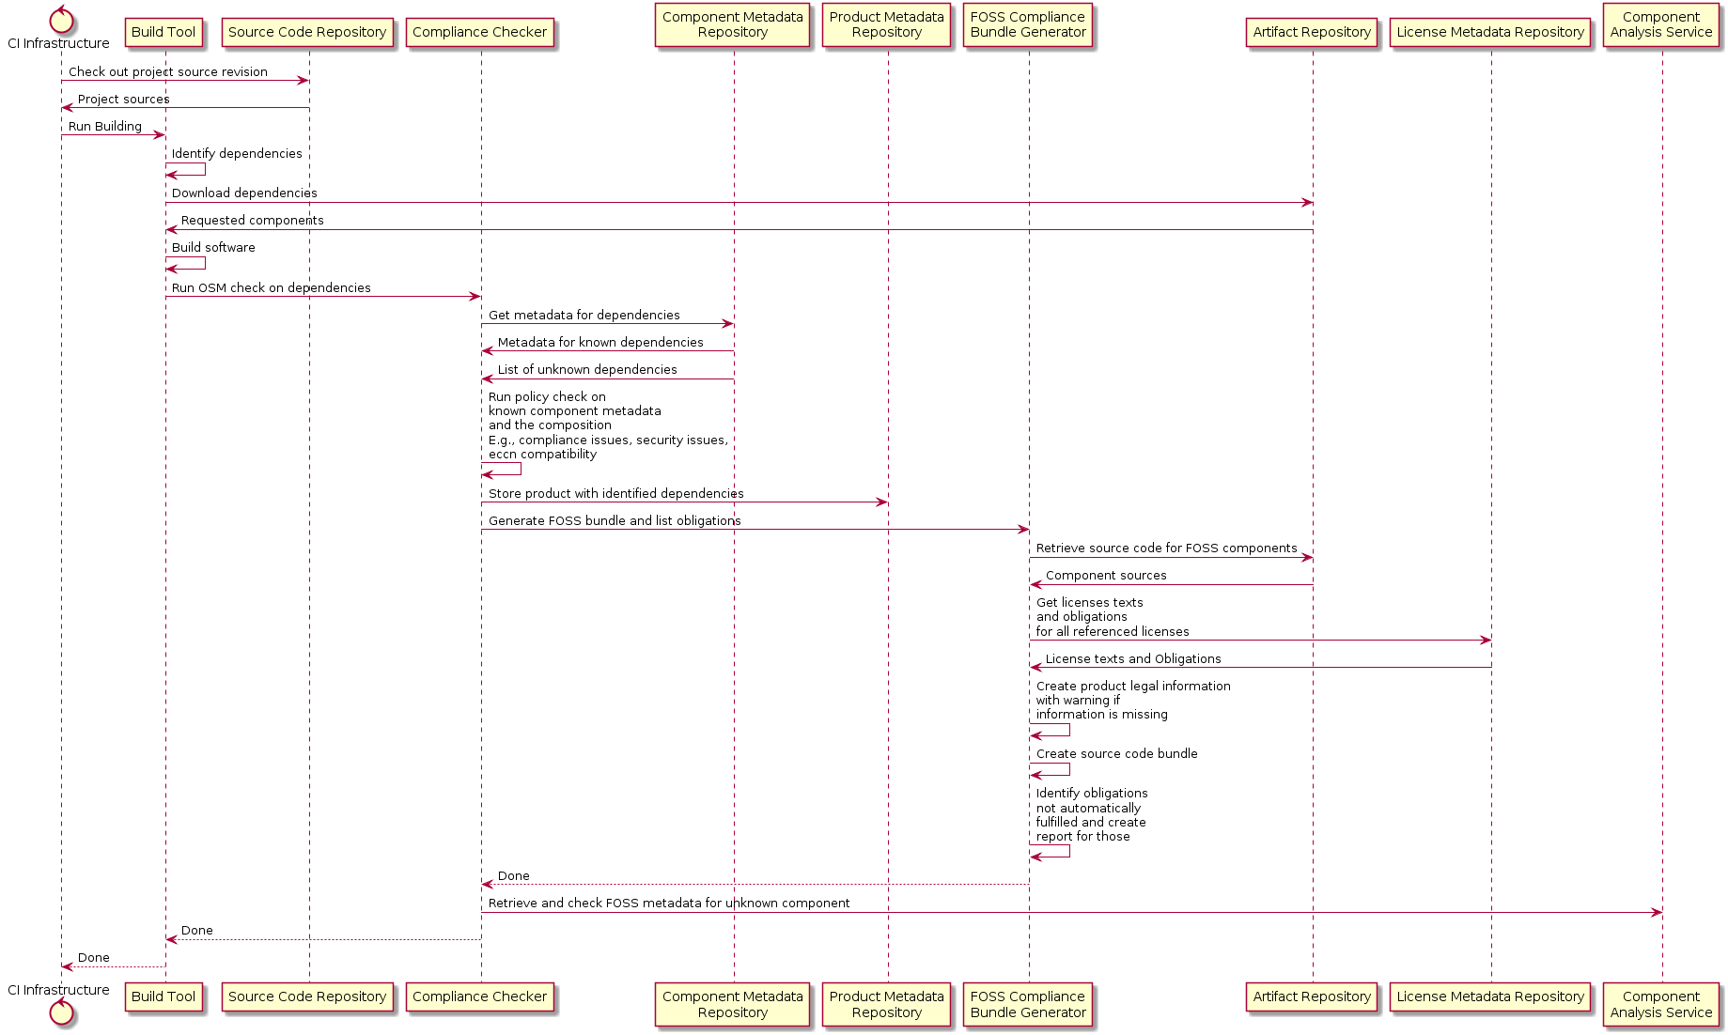
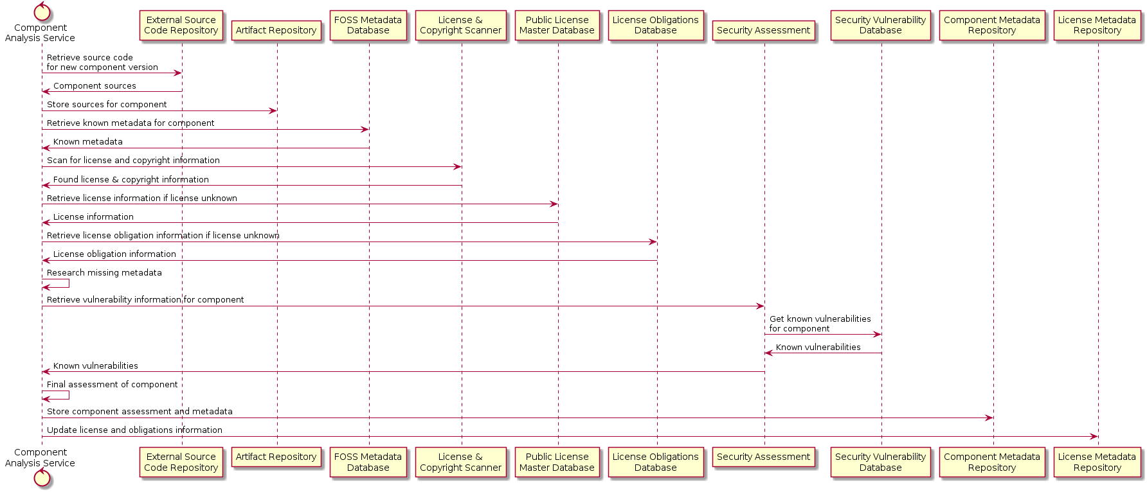
Process Discussion From Last TIme
Processes
Compliance check
Component clearing

Slide 22
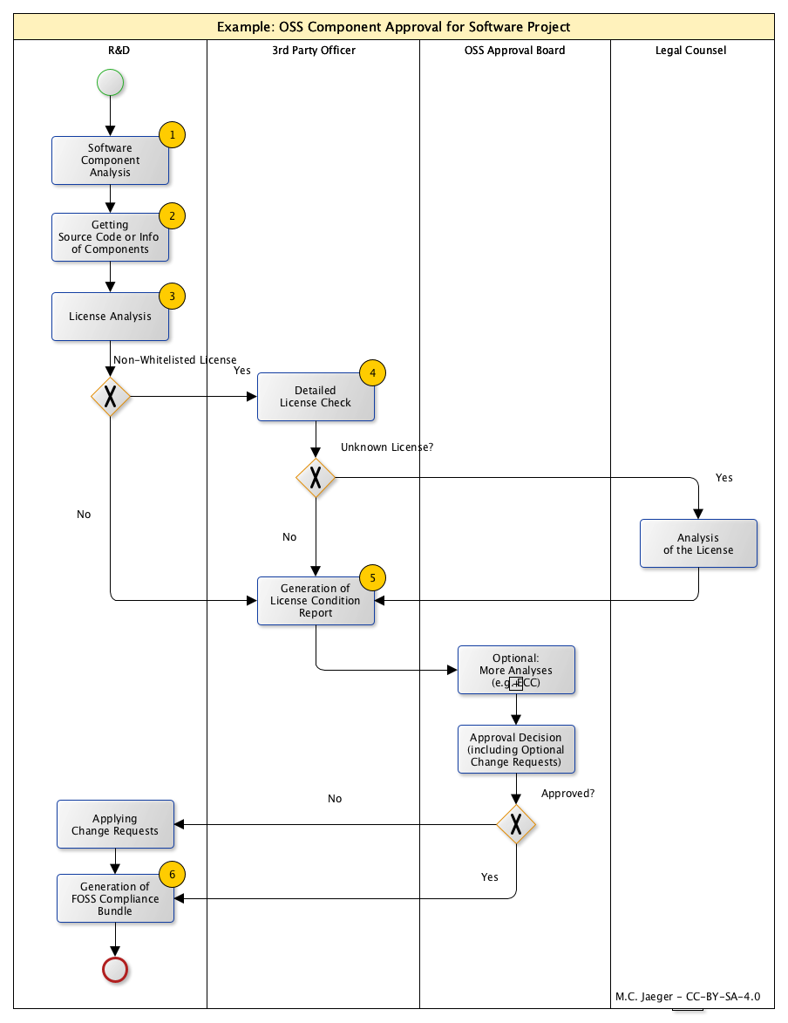
Process Discussion - As BPMN
BPMN
Standard notation from the workflow area
Used by many process modelling and management tools
Two examples
How an approval workflow could look like
How component approval could be modelled

Slide 23
Exercise: What is missing
Let’s look back
Exercise is to identify needed processes
Component approval, OK
License approval
Contribution process
Product approval

Slide 24
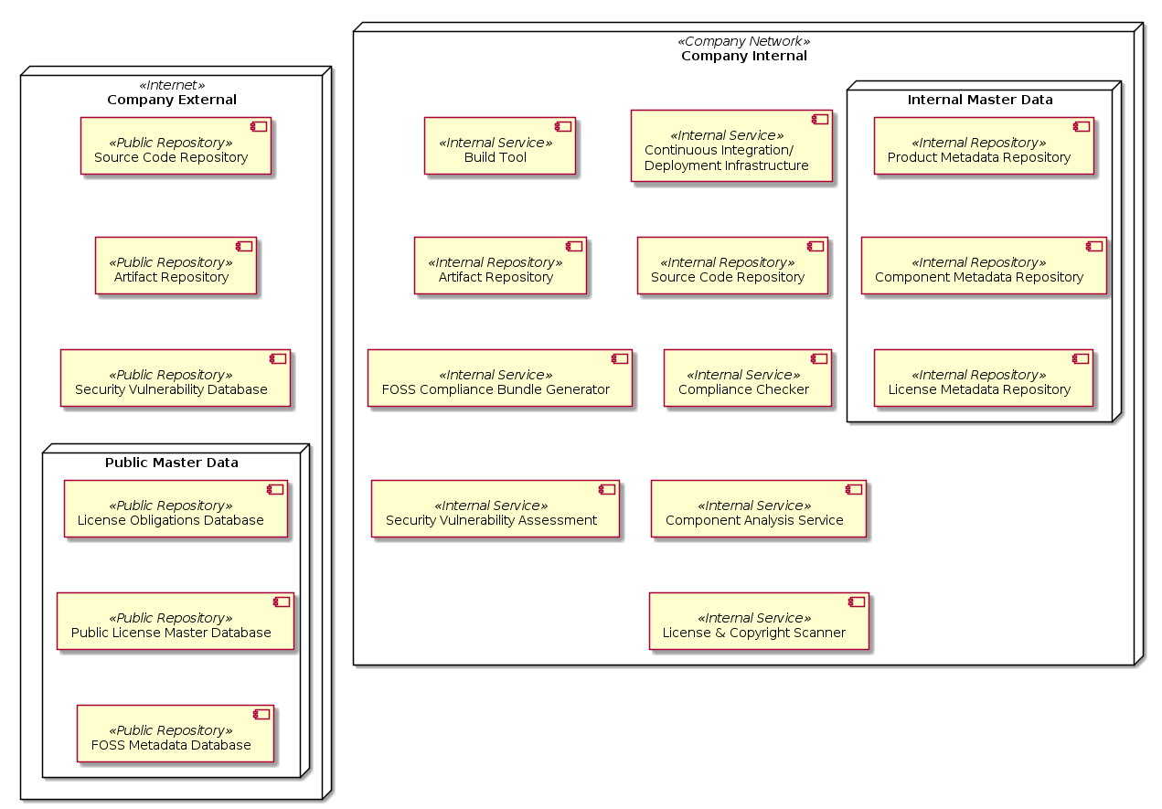

Slide 25
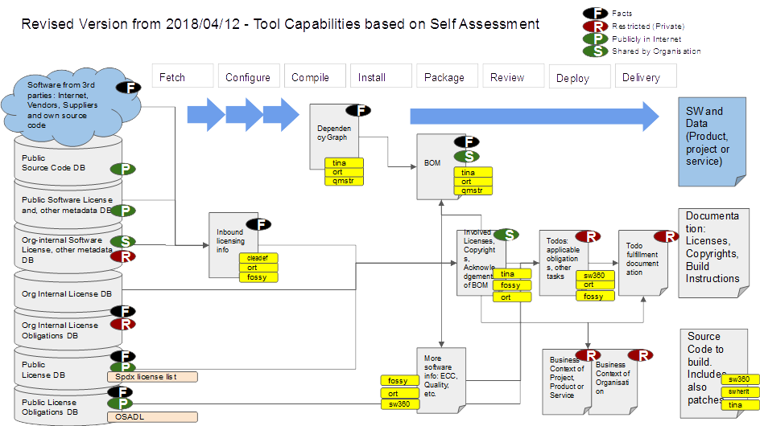

Slide 26
Lunch

Slide 27
Data Models Discussion

Slide 28
Data Models Discussion
Data
What is exchanged
What is missing
Notation

Slide 29
FASTEN
Fine-Grained Analysis of Software Ecosystems as Networks

Slide 30
EU Project FASTEN
(please see separate slides)
Mirko.Boehm@endocode.com

Slide 31
Group Break Out

Slide 32
Group Breakout on Specific Topics
(flexible content)
* Tooling / code integrations
* Process
* Models

Slide 33
Wrap Up and Closing

Slide 34
Wrap Up and Closing
Next meeting
Volunteering to host next meeting? (BMW Helio)
Narrow down time frame for Doodleing:
Proposal: Last Week of June, First Week of July.
Next Steps
Refer to documentation

Slide 35
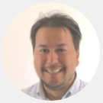
Thank you for your attention … questions?
Michael C. Jaeger
Siemens AG Corporate Technology Otto-Hahn-Ring 6 81379 München
michael.c.jaeger@siemens.com
FOSSology links https://code.siemens.com/fossology/fossologyng
https://github.com/fossology/fossology
SW360 links https://code.siemens.com/sw360/sw360portal
https://github.com/sw360/sw360portal

